Slide 1

In Trusted Components, We (Mostly) Trust Suyash Gupta, Sajjad Rahnama, Shubham Pandey, Natacha Crooks, Mohammad Sadoghi

Slide 2
This talk in one line
The Bad News Trusted hardware
cannot be used
to efficiently reduce replication factor to 2f+1.
The Good News
Trusted hardware
can be used
to design more
scalable and efficient
3f+1 protocols.

Slide 3



BFT Replicated State Machine
Safety and Liveness in the presence of arbitrary Failures

Slide 4


BFT Consensus Primer
How to create a consistent log of operations at all replicas?
Partial Synchrony Model
F

Slide 5

BFT Consensus Primer
T1
T1 = banana!
Request is prepared
Non – Equivocation Phase
Request is committed
Persistence Phase
Execution Phase

Slide 6
Non - Equivocation
Create a prepare quorum: no two prepare quorums can exist for the same transaction at the same slot.
Every quorum needs to intersect in at least one honest replica
!
(n+f+1)/2
F+1
(n+f+1)/2

Slide 7
Persistence Phase
When elect a new leader, must ensure that any committed operation persists across views

Slide 8
Execution Phase
When client receives response:
Whether request has committed
Whether execution result is valid
A
F+1
A
Commit certificate not enough! Need f+1 matching responses
B

Slide 9
The Ugly Side of BFT
Crash Fault Tolerant Systems
2f+1 replicas
Byzantine Fault Tolerant Systems
3f+1 replicas
Equivocation is root cause of higher replication factor

Slide 10
Can Trusted Hardware Save the Day?
Trusted Counters
Trusted Logs
Trusted component attest order of each transaction. Replicas cannot equivocate.
A2M, TrInc, Min BFT, Mi ZZ, Hotstuff-M, Damysus
Trust-BFT protocols => 2f+1 enough for safety

Slide 11

The End
Identify three limitations with existing Trust-BFT protocols.
Worse performance!

Slide 12
1) Limited Responsiveness
T1
T1 = banana!
Request is prepared
Non – Equivocation Phase
Request is committed
Persistence Phase
Execution Phase

Slide 13
1) Limited Responsiveness
T1
T1 = banana!
Request is prepared
Replicas that vote commit eecute
F+ 1 replicas vote prepare
Request is committed
F+1 replicas vote commit

Slide 14
1) Limited Responsiveness
T1
T1 = banana!
Request is prepared
Replicas that vote commit eecute
Request is committed
F+1 replicas vote commit

Slide 15


1) Limited Responsiveness
T1
T1 = banana!
Request is prepared
Replicas that vote commit eecute
Request is committed

Slide 16
1) Limited Responsiveness
T1
Request is prepared
Request is committed

Slide 17
1) Limited Responsiveness
F+1 (=2) replicas know about the commit certificate.
Only one honest node replies to client.
This is not enough to validate the response!

Slide 18
1) Limited Responsiveness
T1
Request is prepared
Request is committed
Something is wrong! I want a view change
Need at least f+1 votes to VC

Slide 19
1) Limited Responsiveness
T1
Request is prepared
Request is committed
Something is wrong! I want a view change
Cannot accept messages with lower view

Slide 20
2) Lack of Parallelism
Every message sent requires an attestation bound to a specific sequence number
Replicas cannot process transactions in parallel or out of order
Despite 2f+1, Trust-BFT achieves lower throughput than trad. BFT

Slide 21


3) The Elephant in the Room Enclave
Rollbacks
Implementations of counters/logs with traditional trusted hardware (SGX) etc. become unsafe
Implementations using TPMs, persistent counters prohibitively expensive

Slide 22
3) The Elephant in the Room Enclave
Simulated Access Cost (ms) | Throughput (MinBFT)
1 | 39K
1.5 | 37K
2 | 35K
2.5 | 34K
3 | 32K
10 | 19K
30 | 3K
100 | 994
200 | 496
BFT without trusted hardware: 40K
(f =32)
SGX
Notes:
Similarly, accessing
current SGX persistent counters or TPMs currently
takes between 80 ms to 200 ms for TPMs and between 30 ms
to 187 ms for SGX
The system relies on CMAC for MAC, ED25519 for DS-based
signatures and SHA-256 for hashing.
SGX Enclaves. We use Intel SGX for Linux
Oracle Cloud Infrastructure (OCI) and deploy
up to 97 replicas on VM.Standard.E3.Flex machines (16 cores
and 16 GiB RAM) with 10 GiB NICs

Slide 23

Are we doomed?
?

Slide 24
Introducing our Flexi Trust Protocols
Return to 3f+1 replicas
Trusted hardware becomes useful to
Reduce number of phases
Reduce communication cost

Slide 25
Flexi Trust Protocols
Use trusted counter at primary only
Supports parallel consensus invocations
No responsiveness issue
Reduces number of phases compared to
standard BFT protocols

Slide 26
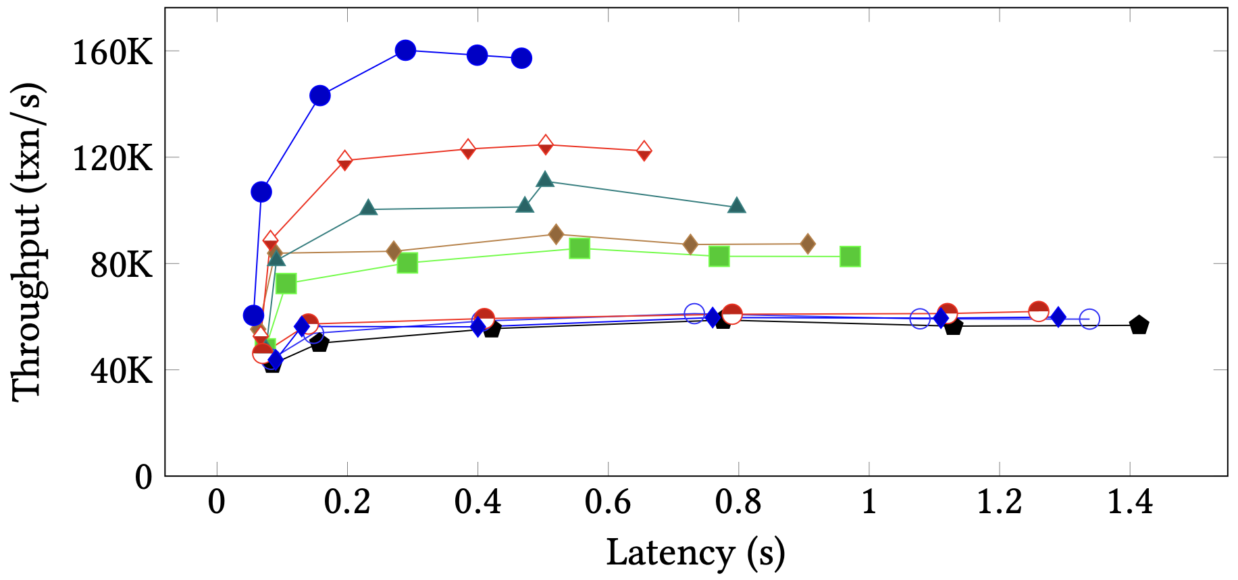
Flexi Trust Protocols
Notes:
F=8, batch size 500

Slide 27
Conclusion
BFT protocols with trusted hardware and 2f+1 replicator factor
Are not responsive
Do not support parallel consensus invocations
Invoke hardware on every request
Flexi Trust protocols harness power f trusted hardware by returning to 3f+1.

Slide 28


Any questions?
To Appear at Eurosys’23
The brains behind this work: suyash.gupta@berkeley.edu

